Slide 1
A comparison of statistical approaches to provider profiling with respect to provider volume
July 29, 2019
Presented by Jessica Lavery, MS, Research Biostatistician
Work done in collaboration with Kathy Panageas, DrPH, Allison Lipitz-Snyderman, PhD, Diane Li, BA, Peter Bach, MD

Slide 2
Abstract
Provider profiles, or report cards, are routinely developed to assess the quality of care for various conditions and procedures, as in the Centers for Medicare and Medicaid Services’ Hospital Compare and ProPublica’s Surgeon Scorecard. Profiling providers of surgical cancer care poses challenges related to a high number of low-volume providers, particularly if analyses are to be undertaken separately for specific cancer sites. Often, different thresholds are used to define low-volume providers that are then excluded from analyses and/or public reporting. We performed a head-to-head comparison of fixed and random effects methods of profiling providers of surgical cancer care with particular emphasis on low volume providers. We compared the width of the confidence interval for the estimate of the hospital effect, detection of outliers, and correlation of performance measures between methods.
Notes:
15 minute presentation

Slide 3





Provider profiles
Notes:
A profile is a way of measuring and presenting quality of care at the provider level, where the provider is assigned a score, a grade, a ranking, etc.
Currently, profiles exist for common medical conditions or procedures such as cardiovascular conditions and orthopedic procedures such as hip and knee replacements.
Examples of existing profiles include: US News’ Best Hospitals list, CMS’ Hospital Compare, and ProPublica’s Surgeon Scorecard, among others.

Slide 4

Profiling surgical cancer care
Notes:
Quality measurement has been credited for improvement in outcomes in other areas with existing profiles, such as orthopedic surgery
However, there’s a deficiency for this kind of work in cancer care
There have been profiles/parts of profiles related to cancer care, but at MSK we’re interested in assessing the feasibility of creating a comprehensive resource by major cancer site and are starting with cancer-directed surgeries.
Surgery is a primary modality of cancer treatment, and over 80% of patients with breast and colorectal cancer for instance undergo surgical treatment
If we’re able to create resource that can aid hospitals in quality improvement, even small improvements can have substantial impact
We’re talking about surgeries, so I’d like to clarify that in this context, I’m going to refer to the provider at the hospital level (not the surgeon level)

Slide 5
Profiling surgical cancer care
Population: Medicare fee-for-service beneficiaries aged 66 years and older undergoing cancer-directed surgery between 2011-2013 at >3,000 hospitals
12 cancer sites
Potential quality measure: 30-day complications
Bones and joints
Breast
Colorectal
Gastroesophageal
Kidney
Liver
Lung
Ovary
Other gynecologic
Pancreas
Prostate
Sarcoma
Notes:
Setting: Fee-for-service Medicare, we looked at beneficiaries aged 66 years and older undergoing cancer-directed surgery between 2011-2013 at hospitals nationally.
12 cancer sites analyzed separately and in aggregate

Slide 6
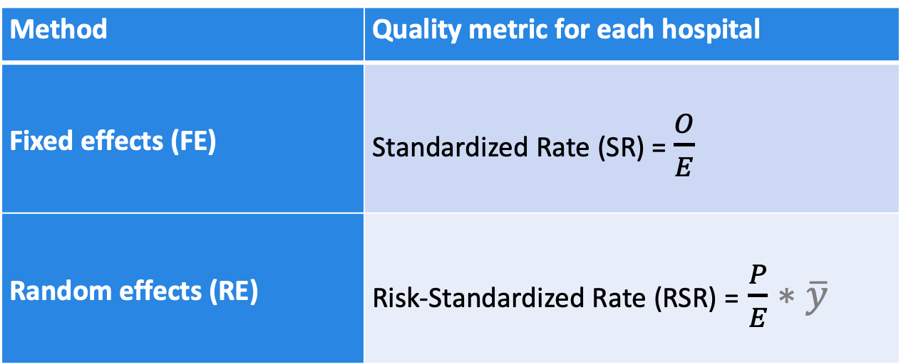
Statistical approaches to provider profiling
Method | Quality metric for each hospital
Fixed effects (FE) | Standardized Rate (SR) = $\frac{O}{E}$
Random effects (RE) | Risk-Standardized Rate (RSR) = $\frac{P}{E}∗\overline{y}$
He K, Kalbfleisch JD, Li Y, Li Y. Evaluating hospital readmission rates in dialysis facilities; adjusting for hospital effects. Lifetime Data Anal. 2013;19(4):490-512.
Kevin(Zhi) He and Wenbo Wu (2019). FEprovideR: Fixed Effects Logistic Model with High-Dimensional Parameters. R package version 0.1.0.
Notes:
Statistical approaches to provider profiling
What’s known: FE has been shown to be more accurate for extreme providers, but RE has smaller overall MSE (Kalbfleisch slides from JSM 2018)

Slide 7
Deciding which approach to use
In this setting, we have a high number of extremely low volume providers
Estimating outcomes to low volume providers introduces analytical challenges related to precision and accuracy
The existing literature comparing statistical methods for profiling providers largely ignores low-volume providers
Existing profiles impose minimum volume criteria for profiling
Notes:
In this setting, we have instances of extremely low volume, and for a majority of providers
Existing profiles impose minimum volume criteria for profiling, that threshold is generally arbitrary
The literature comparing approaches to profiling ignores low-volume providers

Slide 8
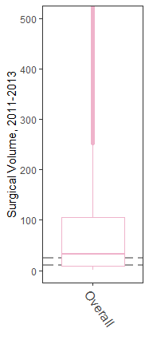
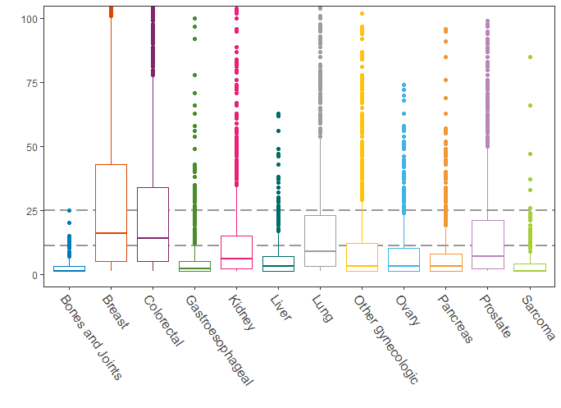
Provider Surgical Volume, 2011-2013
Notes:
Boxplot of distribution of hospital surgical volume overall (left) and by cancer site (right)
Dashed lines refer to commonly employed cutoffs for profiles (11, 25)
Y-axis across sites ranges from 0 to 500, where the median volume is 34 surgeries.
Y-axis by site ranges from 0 to 100 and we can see that benchmarking the estimates of surgical volume against some commonly used cutoffs for profiling, we would be unable to report on outcomes to >50% of providers. / In this setting, if providers below a volume threshold of 11 or 25 are excluded, we’re unable to profile on >50% of providers for any of the cancer surgeries examined

Slide 9
Medicare FFS Surgical Volume, 2011-2013
Cancer site | Number of surgeries | Number of hospitals | Median (Q1, Q3) number of surgeries per hospital
12 cancer sites | 340,489 | 3,776 | 34 (9, 108)
Bones and joints | 119,217 | 302 | <3 (<3, 3)
Breast | 119,217 | 3,537 | 17 (5, 34)
Colorectal | 85,857 | 3,471 | 14 (5, 34)
Gastro-esophageal | 7,899 | 1,512 | <3 (<3, 5)
Kidney | 24,578 | 1,998 | 6 (<3, 15)

Slide 10
Medicare FFS Surgical Volume, 2011-2013
Cancer site | Number of surgeries | Number of hospitals | Median (Q1, Q3) number of surgeries per hospital
Liver | 3,562 | 556 | 3 (<3, 7)
Lung | 33,513 | 1,844 | 9 (3, 23)
Ovary | 8,805 | 1,137 | 3 (<3, 10)
Other gyn | 18,603 | 1,615 | 3 (<3, 12)
Pancreas | 6,391 | 785 | 3 (<3, 8)
Prostate | 29,207 | 1,600 | 7 (<3, 21)
Sarcoma | 1,984 | 506 | <3 (<3, 4)

Slide 11
Case study
Comparison: Fixed Effects (FE) vs Random effects (RE)
Cohort: 85,860 patients undergoing surgery for colorectal cancer at 3,598 hospitals between 2011-2013
Outcome: 30-day major surgical complications
Notes:
Definition of a major surgical complication: one or more of pulmonary failure, pneumonia, myocardial infarction, deep venous thrombosis/pulmonary embolism, acute renal failure, hemorrhage, surgical site infection, gastrointestinal bleeding, acute liver failure or death during the surgical stay through 30 days after discharge

Slide 12
Comparison of approaches
Assessed agreement in rank across methods using weighted kappa
Examined provider ranking based on the distribution:
10% - 20% - 20% - 20% - 20% - 10%
Examined distribution stratified by volume
Compared the precision of standardized rates based on the half-width of the 95% confidence interval
Compared detection of outliers based on the 95% confidence interval of the standardized rate
Notes:
Assessing agreement, outliers, and precision
For assessing agreement, considered the top and bottom 10%, assuming that if profiles were created the extremes would be used to identify exemplary hospitals or hospitals in need of a quality improvement initiative. Less concerned with movement in the middle quintiles.
All assessed with respect to volume – is agreement increasing when providers with higher volume are profiled? How does precision change with increasing volume, and is does it change differently across the two methods? Are more/less outliers detected with increasing volume based on the different methods?

Slide 13
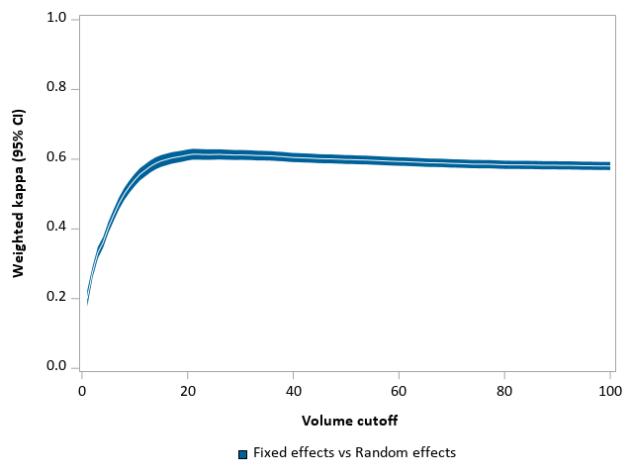
I. Assessing agreement: Weighted kappa by volume
Notes:
Agreement: Weighted kappa by volume
Each kappa was calculated where volume was ≤ the cutoff, i.e. the Kappa at 20 is the Kappa among hospitals with a volume ≤20
Poor agreement among FE and RE
Agreement changes substantially for hospitals with a volume ≤20 compared to hospitals with a volume >20. Levels off as volume increases beyond the graph
Highest kappa is still only slightly greater than 0.6
TRANSITION: Agreement poor for FE to RE
Want to visually inspect where disagreement is occurring.

Slide 14
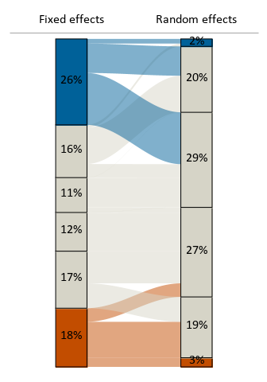
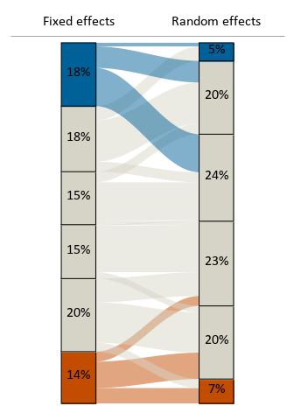
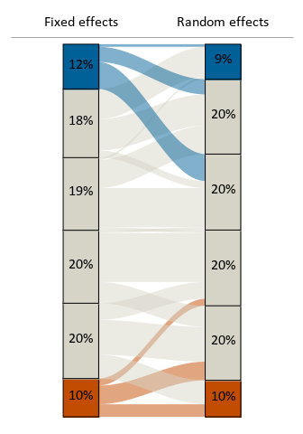

Hospital ranking based on standardized rates
Volume ≤ 11
Volume ≤ 25
Volume ≤ 100
Notes:
Orientation: Blue = higher rank (better performance), Orange = lower rank (worse performance)
Hospitals grouped into top and bottom decile and remaining quintiles, then stratified by volume
Among hospitals with a volume ≤11
The FE method identified 26% of providers to be in the top decile, 18% of providers to be in the bottom decile, whereas RE methods identified only 2% and 3% of low-volume providers to be in the top and bottom decile, respectively.
We can see that there’s not a lot of movement in the gray bars (middle quintiles) across methods), just that the providers identified in the extreme deciles with FE move towards the middle for RE.
Among hospitals with a volume ≤25
Still a high proportion of “low” (<25) volume providers identified in the extremes with FE, less so for RE
But can now see that the % of providers moving from the extremes to the middle from FE to RE is decreasing, as demonstrated by the width of the blue and orange flows at the top and bottom
Among hospitals with a volume ≤100 (almost all hospitals)
Even less movement from the extremes to the middle from FE to RE
More similar distribution of ranked groups across methods
Conclusion: Similar to the weighted kappa figure, we can see that with increasing volume, FE and RE are in better agreement though there is still some movement from the extremes to the middle from FE to RE.
Less movement from extremes in RE to middle of FE

Slide 15
II. Precision of estimates
Notes:
The x-axis shows volume on a continuous scale
Each dot represents the precision of the standardized rate for a hospital
We can see that FE has a wider confidence interval than RE
Notably, the pattern of increasing precision with increasing volume is different across the methods
With FE, there’s an “L-shape”, where precision increases with increasing volume
With RE, there are some low-volume providers whose precision is as good as higher volume providers, but there is more noise around the half-width of the CI for low-volume providers, in both directions
MacKenzie (2015): RE methods more precise

Slide 16
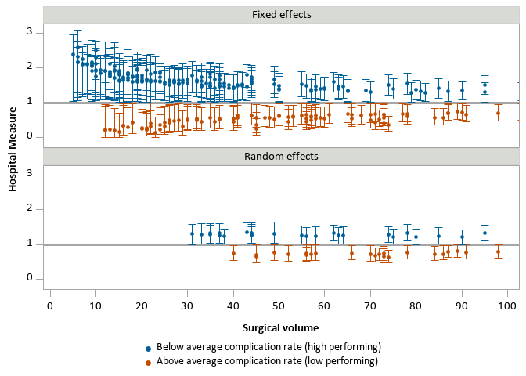
III. Detection of outliers
Notes:
X-axis is again volume, y-axis is the estimate of the standardized rate per hospital
Top panel is FE, bottom panel is RE
Only hospitals significantly different than average are shown. Blue indicates high-performing outliers; orange indicates low performing outliers.
Hospitals were deemed to be different than average with if the confidence interval for the standardized rate (O/E) did not include 1 (reference line on both plots).
In general, more outliers are identified with FE than RE.
Especially pronounced at low volumes, where RE doesn’t identify any outlying providers with a volume <30.

Slide 17
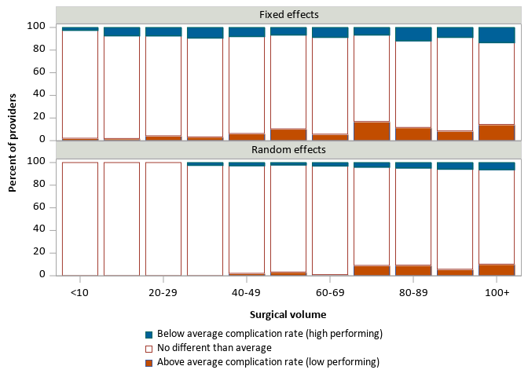
Detection of outliers
Notes:
Looking at similar information in a slightly different way
Now showing the % of providers that are identified as outliers by volume
With FE, though there were more outliers identified in the low-volume setting than with RE, we can see that it’s still a small percentage of providers that are identified as outliers, and that the percentage of outliers detected is higher at higher volumes.

Slide 18
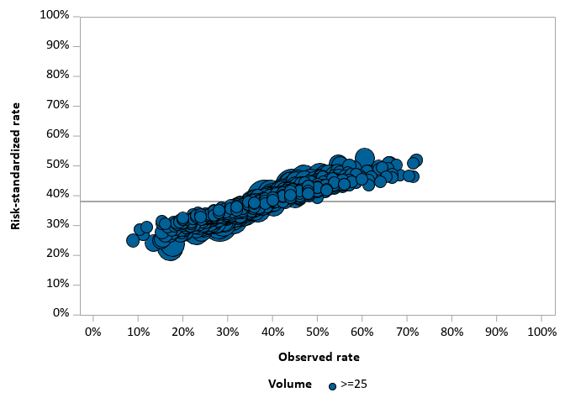
Random effects model
Notes:
X-axis shows observed rate, y-axis shows the risk-standardized rate with the RE model
Size of the bubble corresponds to the surgical volume
Among providers whose volume is >=25, we can see that in general their observed rate is equal to their risk-standardized rate. There is not a high-degree of shrinkage

Slide 19
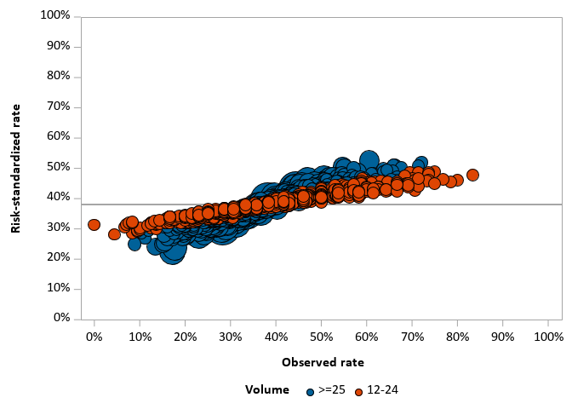
Random effects model
Notes:
Can compare this to hospitals with a surgical volume between 12 and 25, where the predicted estimate (risk-standardized rate) starts to move from the extremes to the average, tilting the line from a 45-degree line closer to a horizontal line.

Slide 20
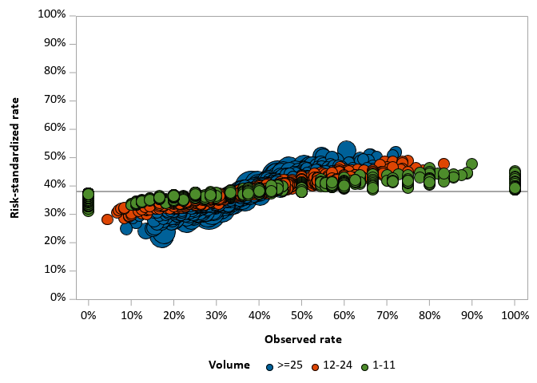
Random effects model
Notes:
Looking at even lower volume providers (<11), we see this effect even more, especially for low-volume providers who had surgeries followed by no complications or that had all of their surgeries followed by complications.
This is expected with the random effects method, but when we set out on this analysis we weren’t sure to what extent this would play a role.

Slide 21
Conclusions
Agreement
Poor agreement between FE and RE, particularly in the low volume setting
Agreement increases with increasing volume, up until ~30 surgeries
Precision
RE has smaller CI than FE methods
Precision increases as volume increases, but the pattern is different in FE and RE
Detection of outliers
With RE, no outliers detected for hospitals with a volume <30
FE methods identify outliers with a volume as low as 5

Slide 22
Implications & future work
The choice of method matters in the low-volume setting
Future work planned to evaluate whether these results are driven by providers with extremely low volume or the high proportion of low-volume providers
Other methods may handle low-volume providers differently. Future work planned to incorporate comparison with Bayesian methods, fixed effects with random intercepts (FERE)
Simulation studies to assess which method is most accurate for low-volume providers
Careful consideration needs to be given to the cutoffs that are imposed for analysis and/or reporting

Slide 23


Thank you!
laveryj@mskcc.org
www.JessicaLavery.com

